Slide 1
Software Development on Java
Dzmitry Marchankau 2023

Slide 2
Software development principles and patterns
SOLID, software development principles
Common Java patterns
MVC pattern
Enterprise patterns

Slide 3
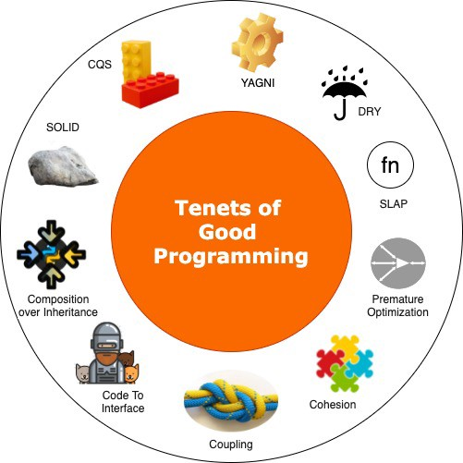
Top evergreen principles

Slide 4
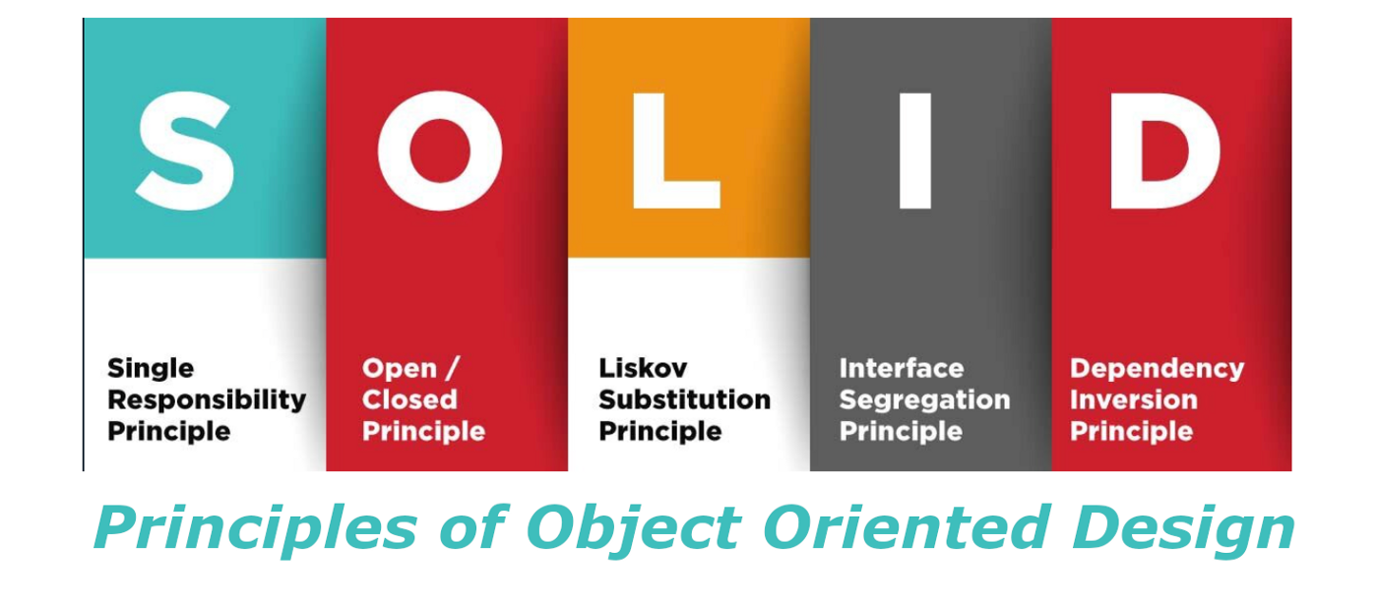
SOLID principles

Slide 5
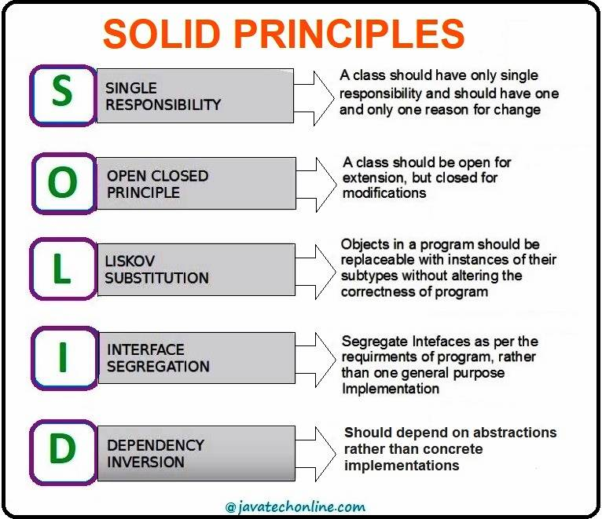
SOLID principles

Slide 6
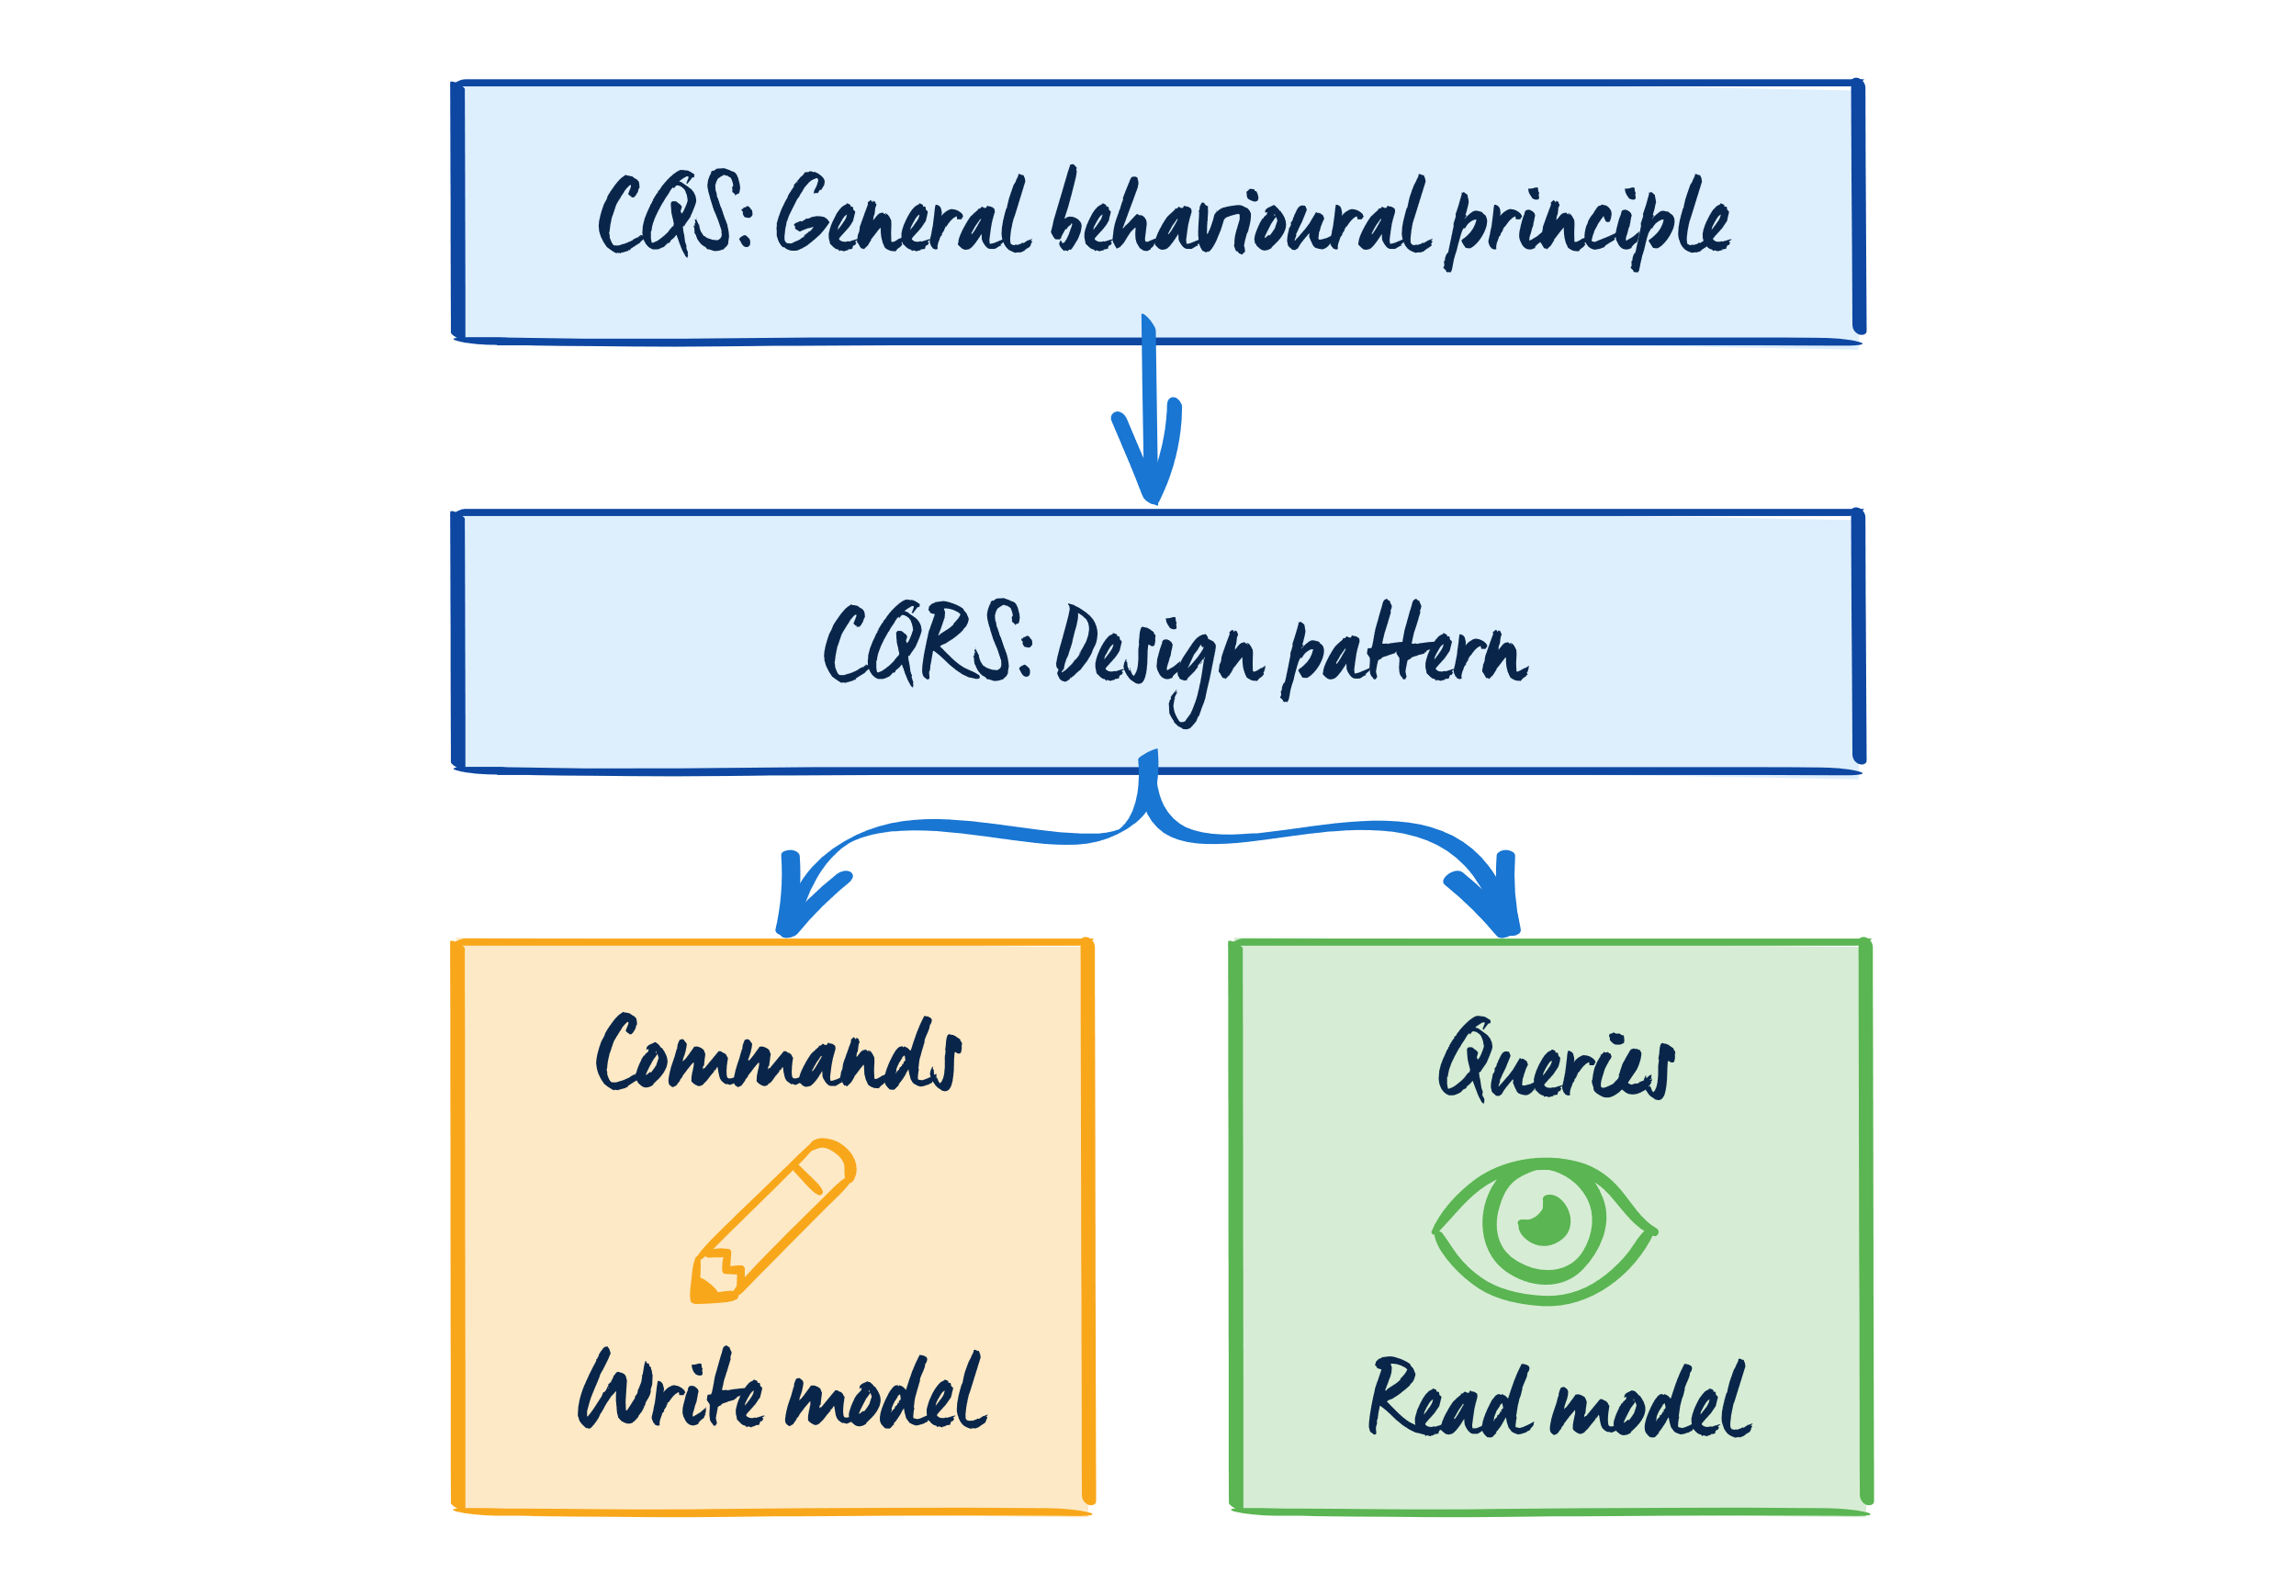
CQS/CQRS (command-query)

Slide 7
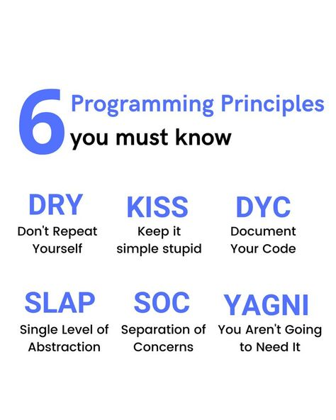
Other valuable principles

Slide 8
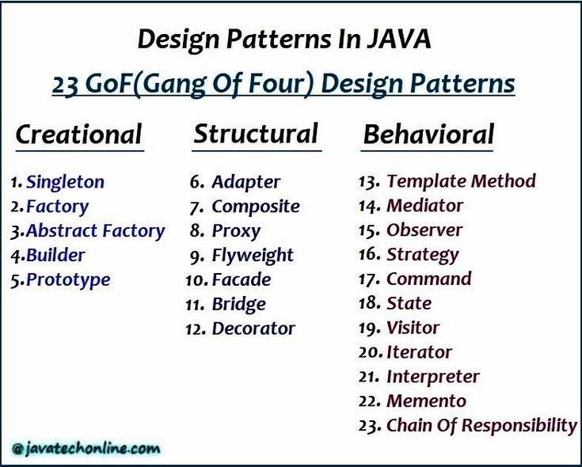
Java design patterns - GoF

Slide 9
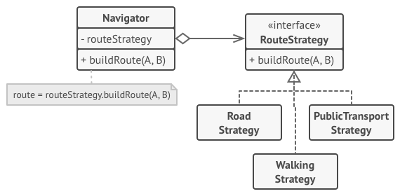
Strategy pattern

Slide 10
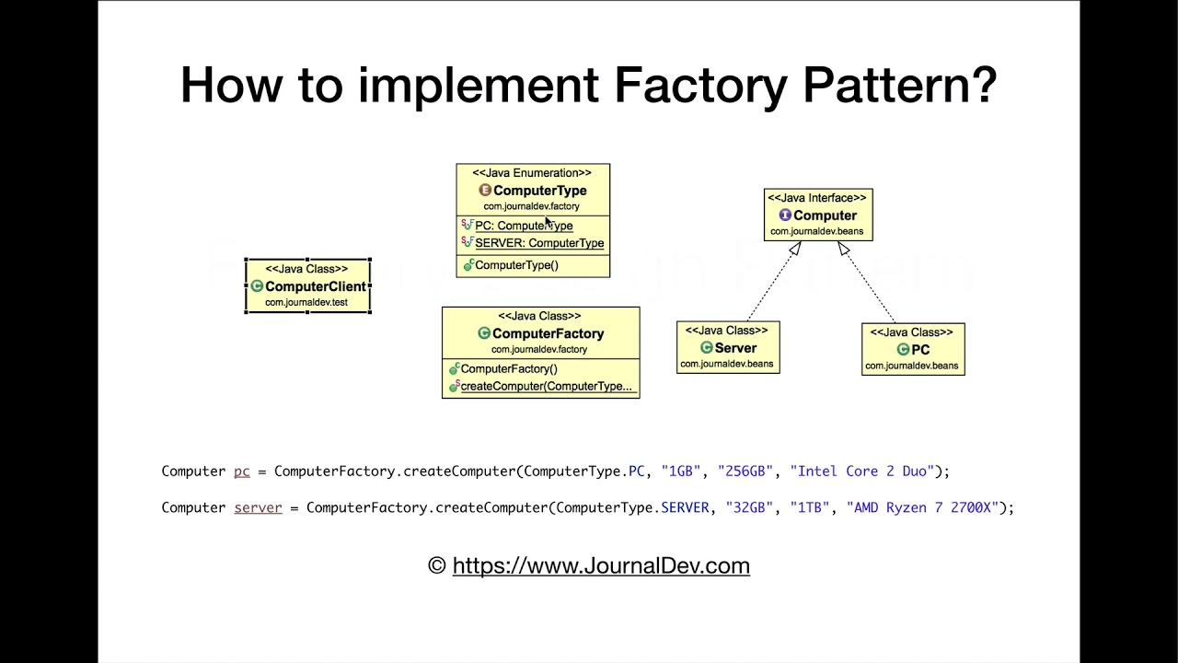
Factory pattern

Slide 11
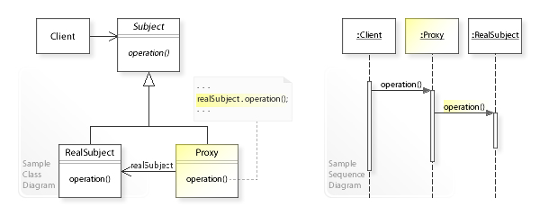
Proxy pattern

Slide 12
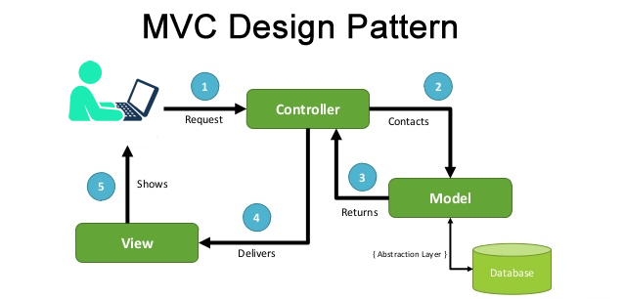
MVC pattern

Slide 13
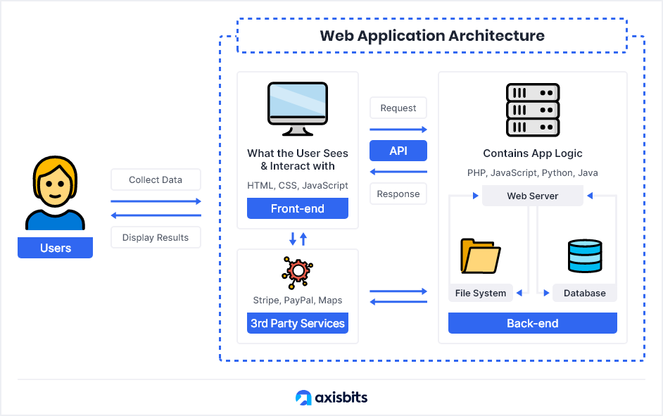
Web application architecture

Slide 14
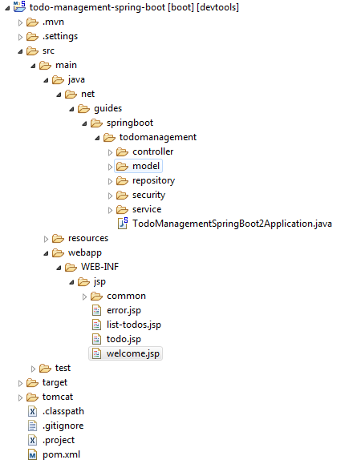
Java web application packages

Slide 15


COMMON PRINCIPLES
Separation of concerns
Coupling
Cohesion

Slide 16

SEPARATION OF CONCERNS
“
SEPARATION OF CONCERNS is a design principle for separating a computer program into distinct sections. Each section addresses a separate concern, a set of information that affects the code of a computer program.
”
Separation of concerns is tightly connected with coupling and cohesion.
Crucial everywhere
Can be embodied in different ways
Impacts many QAs
Programming, software architecture, solution architecture, and enterprise architecture.
By aspects, components, modules, services, layers, bounded contexts, architecture domains.
Maintainability, scalability, testability, fault tolerance, development distributability, deployability and others.
Notes:
Source:
https://en.wikipedia.org/wiki/Separation_of_concerns

Slide 17
COUPLING
“
In software engineering, COUPLING is the degree of interdependence between software modules; a measure of how closely connected two routines or modules are; the strength of the relationships between modules.
”
Applicable on different levels: classes, components, packages, services, systems, bounded contexts.
No coupling
Loose coupling
High coupling
Notes:
Source:
https://en.wikipedia.org/wiki/Coupling_(computer_programming)

Slide 18
COHESION
“
”
In computer programming, COHESION refers to the degree to which the elements inside a module belong together.
Applicable on different levels: classes, components, packages, services, systems, bounded contexts.
High cohesion
Low cohesion
Notes:
Source:
https://en.wikipedia.org/wiki/Cohesion_(computer_science)

Slide 19
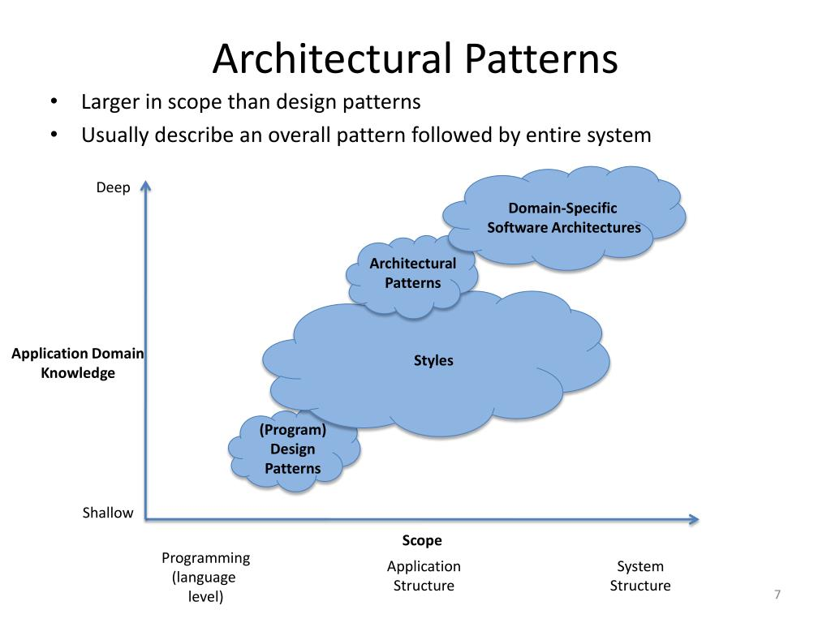
Architectural patterns and styles

Slide 20

ARCHITECTURAL STYLES
MONOLITH
LAYERED ARCHITECTURE
MICROSERVICES
EVENT-DRIVEN ARCHITECTURE
BIG DATA ARCHITECTURE
REST
OTHER STYLES

Slide 21
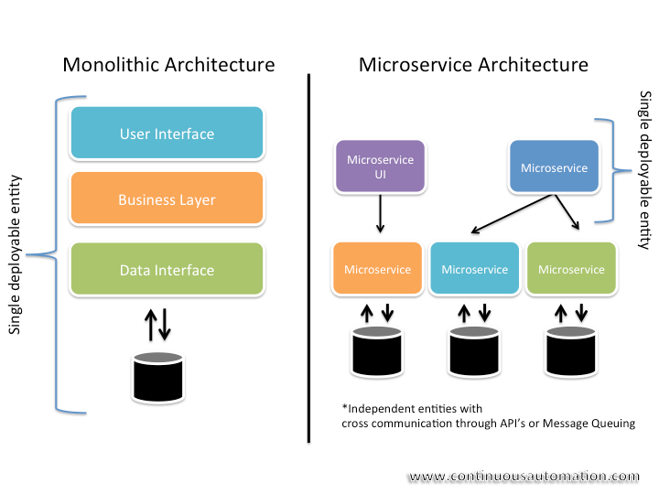
Monolith and microservices

Slide 22
MicroserviCes
The structure of the system is organized as a set of loosely coupled, collaborating services. Such architecture is built around the the single responsibility principle.
Bounded Context X
Bounded Context Y
Service A
Service C
Service D
Service B

Slide 23
“
As I hear stories about teams using a microservices architecture, I've noticed a common pattern.
Almost all the successful microservice stories have started with a monolith that got too big and was broken up.
Almost all the cases where I've heard of a system that was built as a microservice system from scratch, it has ended up in serious trouble.
Martin Fowler
MONOLITH-FIRST STRATEGY
”
Solution design start
More risky
Rationale
Right functional decomposition and responsibility segregation between microservices is easy to fail and then hard to redesign
It may be less risky and more efficient to start from the modular monolith and continue with decomposing it
Modular
monolith
Microservice
Notes:
Source:
https://martinfowler.com/bliki/MonolithFirst.html

Slide 24
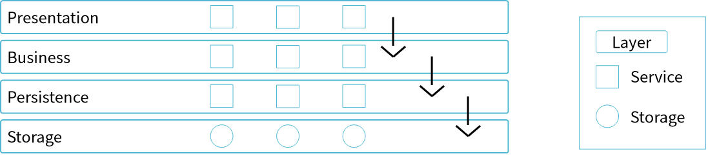
LAYERED ARCHITECTURE
The structure of the system is organized into set of layers.
In a strictly layered structure, a layer can only use the services of the layer immediately below it. Many variations of this pattern, lessening the structural restriction, occur in practice (next slides).
Notes:
One of the powerful features of the layered architecture pattern is the separation of concerns among components.

Slide 25
EVENT-DRIVEN Architecture
The event-driven architecture is made up of highly decoupled, single-purpose event processing components that asynchronously receive and process events.
Highly decoupled, single-purpose event processing components that asynchronously receive and process events
Main goal of applying this style can be improving scalability and/or performance
Two main topologies are supported
MEDIATOR
BROKER
Notes:
An event is defined as a change of a system’s state. In event-driven architecture, an event will likely trigger one or more actions or processes in response to its occurrence. Let’s overview the examples of events and the corresponding responses. Events examples – corresponding responses:
Request to reset a password – An email to reset the password is sent to the customer;
A grocery warehouse updates its inventory – An order for more lettuce is placed;
A package arrived was delivered to its destination – The sales ticket is closed;
An unauthorized access attempt was denied – An account is locked and security personnel are notified;
The mediator topology is commonly used when you need to orchestrate multiple steps within an event through a central mediator, whereas the broker topology is used when you want to chain events together without the use of a central mediator.

Slide 26
The mediator topology is useful for events that have multiple steps and require some level of orchestration to process the event.
MEDIATOR
Event
Channel
Event
Processor
Mediator
Event
Event
Processor
Queue
Event
Channel
Notes:
There are four main types of architecture components within the mediator topology: event queues, an event mediator, event channels, and event processors. The event flow starts with a client sending an event to an event queue, which is used to transport the event to the event mediator. The event mediator receives the initial event and orchestrates that event by sending additional asynchronous events to event channels to execute each step of the process. Event processors, which listen on the event channels, receive the event from the event mediator and execute specific business logic to process the event.
The event-mediator component is responsible for orchestrating the steps contained within the initial event.
Event channels are used by the event mediator to asynchronously pass specific processing events related to each step in the initial event to the event processors. The event channels can be either message queues or message topics.
The event processor components contain the application business logic necessary to process the processing event.

Slide 27
The broker topology is useful when you have a relatively simple event processing flow and you do not want (or need) central event orchestration.
BROKER
Broker
Event
Event
Processor
Event
Processor
Event
Processor
Event
Processor
Notes:
The broker topology differs from the mediator topology in that there is no central event mediator; rather, the message flow is distributed across the event processor components in a chain-like fashion through a lightweight message broker (e.g., ActiveMQ, HornetQ, etc.).
The event channels contained within the broker component can be message queues, message topics, or a combination of both.
There is no central event-mediator component controlling and orchestrating the initial event; rather, each event-processor component is responsible for processing an event and publishing a new event indicating the action it just performed.

Slide 28
BIG DATA Architecture
A big data architecture is designed to handle the ingestion, processing, and analysis of data that is too large or complex for traditional database systems.
DATA
SOURCES
DATA STORAGE
BATCH PROCESSING
ANALYTICS AND REPORTING
ANALYTICAL DATA STORE
REAL-TIME MESSAGE INGESTION
STREAM PROCESSING
ORCHESTRATION
Notes:
Source:
https://learn.microsoft.com/en-us/azure/architecture/guide/architecture-styles/big-data

Slide 29
REST CONSTRAINTS
REST defines 6 architectural constraints which make any web service a truly RESTful API.
Uniform interface
Client–server
Stateless
Cacheable
Layered system
Code on demand (optional)
Notes:
REST constraints:
https://restfulapi.net/rest-architectural-constraints/

Slide 30
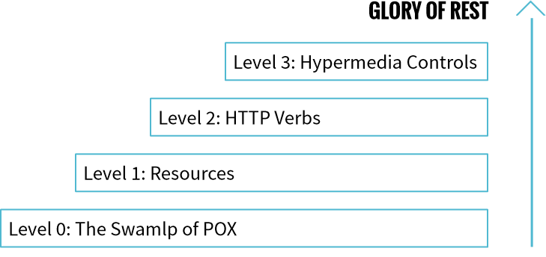
RICHARDSON MATURITY MODEL
A model (developed by Leonard Richardson) that breaks down the principal elements of a REST approach into three steps. These introduce resources, http verbs, and hypermedia controls.
Notes:
Level 0. Essentially, what is done at this stage is using HTTP as a tunneling mechanism for your own remote interaction mechanism, usually based on Remote Procedure Invocation. Let’s consider an example suggested by Martin Fowler. Assume you want to book an appointment with your doctor. First, the appointment software needs to know what open slots the doctor can provide on a given date. It makes a request to the hospital appointment system to obtain that information. In a level 0 scenario, the hospital will expose a service endpoint at some URI. Then you post a document containing the request’s details to that endpoint, and the server returns a document with the requested information. The next step is to book an appointment, which can be done by posting the document to the endpoint. In case of success, a response saying the appointment is booked is received. If there is a problem (someone else booked it before you), then you’ll get an error message in the reply body.
Level 1: Resources. At this stage, rather than making all the requests to a singular service endpoint, you can start talking to individual resources. With the initial query, you might have a resource for the given doctor. The reply carries the same necessary information, but each slot is now a resource that can be addressed individually. With specific resources booking an appointment means posting to a particular slot. If it goes right, you get a similar reply. The difference is that if the appointment needs to be (i.e., to book additional tests), first you need to obtain the appointment resource, which might have a URI like http://royalhope.nhs.uk/slots/1234/appointment. After that, you can post to this resource.
Level 2: HTTP Verbs. Level 2 uses the HTTP verbs as closely as possible to how they are used in HTTP itself. For the list of slots, this means using GET (the use of GET for a request like this is crucial). GET /doctors/mjones/slots?date=20100104&status=open HTTP/1.1 Host: royalhope.nhs.uk To book an appointment, you need an HTTP verb that changes state; for example, a POST or a PUT. If it succeeds, the service replies with a response code of 201 to indicate that there’s a new resource. The 201 response includes a location attribute with a URI that the client can use to GET the current state of that resource in the future. There is also a difference if something goes wrong. Let’s imagine that someone else has booked the session. In this case, a 409 (conflict) seems the right choice to indicate that someone else has already updated the resource in an incompatible way.
Level 3: Hypermedia Controls. The final level introduces the HATEOAS (Hypertext As The Engine Of Application State) acronym. You can begin with the same GET that you have received in Level 2. This time the response has a new element: each slot now has a link element that contains a URI to tell how to book an appointment. Hypermedia controls tell what can be done next and the URI of the resource you need to manipulate to do it. In this case, the response to your POST will contain several hypermedia controls for different things to do next.
Source:
https://martinfowler.com/articles/richardsonMaturityModel.html

Slide 31
OTHER STYLES
NEW WAVE
LESS COMMONLY USED
Nanoservices
SOA
Headless architecture
Microkernel
MACH architecture
Space-based architecture
Data mesh
Notes:
Discuss with the group their experience with the “new wave” styles and less commonly used today such as SOA.

Slide 32
ARCHITECTURAL PATTERNS
PERFORMANCE AND SCALABILITY
INTEGRATION PATTERNS
FAULT TOLERANCE PATTERNS
SECURITY PATTERNS

Slide 33




PERFORMANCE AND SCALABILITY
CQRS
Event Sourcing
Sharding

Slide 34
CQRS
Context/Risk:
In traditional architectures, the same data model is used to query and update a database. This approach has number of disadvantages:
A mismatch between the read and write representations of the data
Data contention can occur when operations are performed in parallel on the same set of data
Can be a negative effect on performance
Managing security and permissions can be more complex
Intention:
Split read and write workloads because they are often asymmetrical, with very different performance and scale requirements
Solution:
Separate reads and writes into different models, using commands to update data, and queries to read data.
Read model
Read storage
Write model
Write storage
Notes:
Sources:
https://docs.microsoft.com/en-us/azure/architecture/patterns/cqrs
http://udidahan.com/2009/12/09/clarified-cqrs/

Slide 35
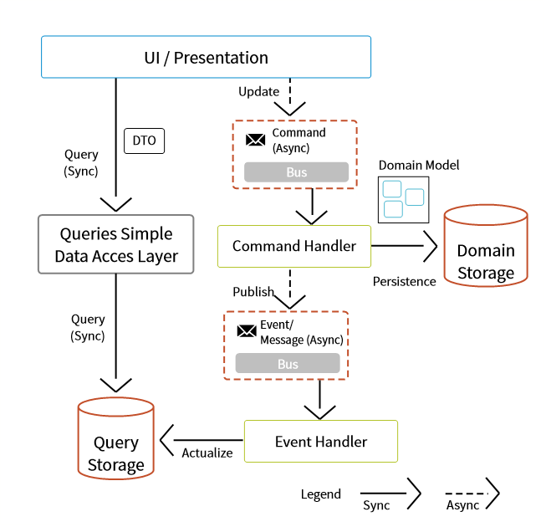
CQRS
Commands should be task-based, rather than data centric. ("Book hotel room", not "set ReservationStatus to Reserved")
Commands may be placed on a queue for asynchronous processing, rather than being processed synchronously.
Queries never modify the database. A query returns a DTO that does not encapsulate any domain knowledge.
Notes:
Consider the following points when deciding how to implement this pattern:
Dividing the data store into separate physical stores for read and write operations can increase the performance and security of a system, but it can add complexity in terms of resiliency and eventual consistency. The read model store must be updated to reflect changes to the write model store, and it can be difficult to detect when a user has issued a request based on stale read data, which means that the operation can't be completed.
Consider applying CQRS to limited sections of your system where it will be most valuable.
A typical approach to deploying eventual consistency is to use event sourcing in conjunction with CQRS so that the write model is an append-only stream of events driven by execution of commands. These events are used to update materialized views that act as the read model.

Slide 36
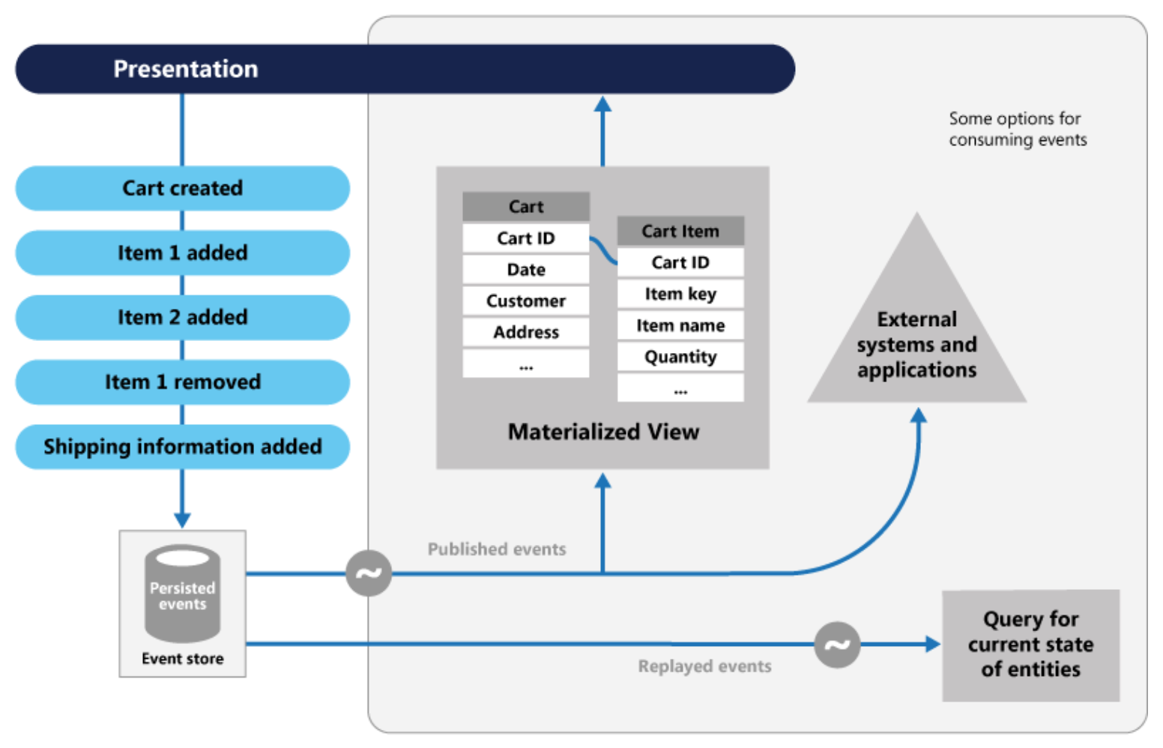
Event sourcing
Events are immutable
Events are simple objects that describe some action that occurred
Events have meaning for a domain expert
Can help prevent concurrent updates
Provides an audit trail that can be used to monitor actions taken against a data store
Decoupling of the tasks from the events provides flexibility and extensibility
Notes:
The Event Sourcing pattern provides the following advantages:
Events are immutable and can be stored using an append-only operation. The user interface, workflow, or process that initiated an event can continue, and tasks that handle the events can run in the background. This, combined with the fact that there's no contention during the processing of transactions, can vastly improve performance and scalability for applications, especially for the presentation level or user interface.
Events are simple objects that describe some action that occurred, together with any associated data required to describe the action represented by the event. Events don't directly update a data store. They're simply recorded for handling at the appropriate time. This can simplify implementation and management.
Events typically have meaning for a domain expert, whereas object-relational impedance mismatch can make complex database tables hard to understand. Tables are artificial constructs that represent the current state of the system, not the events that occurred.
Event sourcing can help prevent concurrent updates from causing conflicts because it avoids the requirement to directly update objects in the data store. However, the domain model must still be designed to protect itself from requests that might result in an inconsistent state.
The append-only storage of events provides an audit trail that can be used to monitor actions taken against a data store, regenerate the current state as materialized views or projections by replaying the events at any time, and assist in testing and debugging the system. In addition, the requirement to use compensating events to cancel changes provides a history of changes that were reversed, which wouldn't be the case if the model simply stored the current state. The list of events can also be used to analyze application performance and detect user behavior trends, or to obtain other useful business information.
The event store raises events, and tasks perform operations in response to those events. This decoupling of the tasks from the events provides flexibility and extensibility. Tasks know about the type of event and the event data, but not about the operation that triggered the event. In addition, multiple tasks can handle each event. This enables easy integration with other services and systems that only listen for new events raised by the event store. However, the event sourcing events tend to be very low level, and it might be necessary to generate specific integration events instead.

Slide 37
SHARDING
Large Data Store
Context/Risk:
A data store hosted by a single server might be subject to the following limitations:
Storage space
Computing resources
Network bandwidth
Geography
Intention:
Storing and accessing large volumes of data and be able to scale when required
Solution:
Divide the data store into horizontal partitions or shards.
Each shard has the same schema, but holds its own distinct subset of the data
Implement a sharding strategy with a shard key that supports the most commonly performed queries
split into shards
Shard 1
Shard N
…
Notes:
Source:
https://docs.microsoft.com/en-us/azure/architecture/patterns/sharding

Slide 38
INTEGRATION PATTERNS

Slide 39
INTEGRATION APPROACHEs
There’s more than one approach for integrating applications. Each approach addresses some of the integration criteria better than others. The various approaches can be summed up in four main integration styles.
FILE TRANSFER
SHARED DATABASE
REMOTE PROCEDURE INVOCATION
MESSAGING
Have each application produce files of shared data for others to consume and consume files that others have produced.
Have the applications store the data they wish to share in a common database.
Have each application expose some of its procedures so that they can be invoked remotely, and have applications invoke those to run behavior and exchange data.
Have each application connect to a common messaging system, and exchange data
and invoke behavior using messages.
Notes:
Patterns following this slide are part of the ‘Messaging’ integration approach.

Slide 40
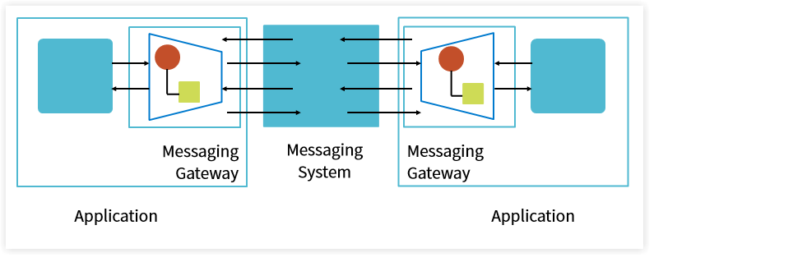
MESSAGING GATEWAY
How do you encapsulate access to the messaging system from the rest of the application?
Use a Messaging Gateway, a class than wraps messaging-specific method calls and exposes domain-specific methods to the application.

Slide 41
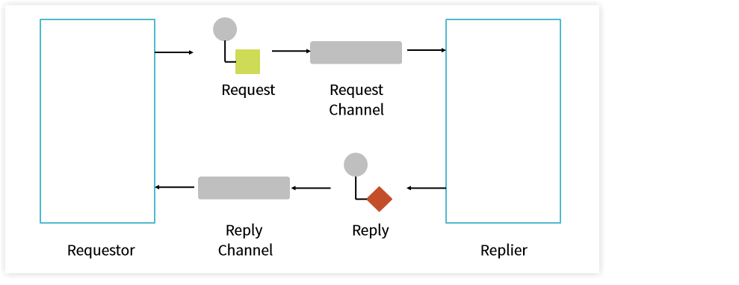
REQUEST-REPLY
When an application sends a message, how can it get a response from the receiver?
Send a pair of Request-Reply messages, each on its own channel.

Slide 42
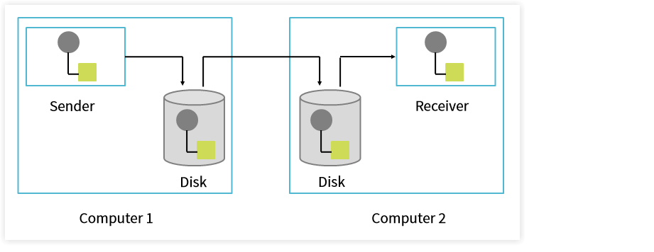
GUARANTEED DELIVERY
How can the sender make sure that a message will be delivered, even if the messaging system fails?
Use Guaranteed Delivery to make messages persistent so that they are not lost even if the messaging system crashes.

Slide 43
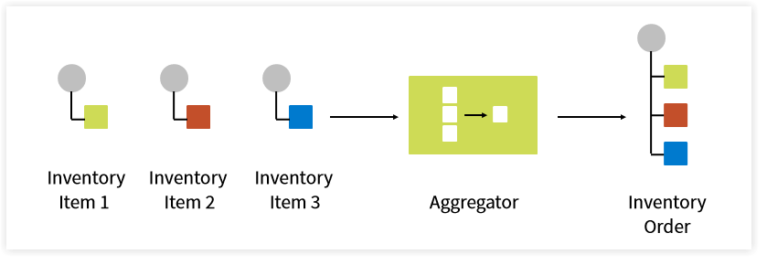
AGGREGATOR
How do we combine the results of individual, but related messages so that they can be processed as a whole?
Use a stateful filter, an Aggregator, to collect and store individual messages until a complete set of related messages has been received. Then, the Aggregator publishes a single message distilled from the individual messages.

Slide 44
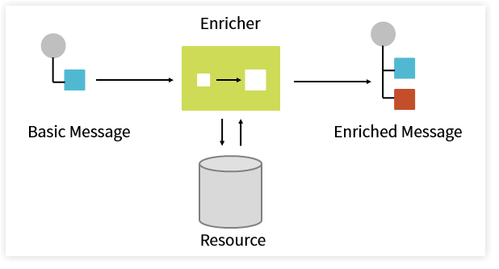
CONTENT ENRICHER
How do we communicate with another system if the message originator does not have all the required data items available?
Use a specialized transformer, a Content Enricher, to access an external data source in order to augment a message with missing information.

Slide 45
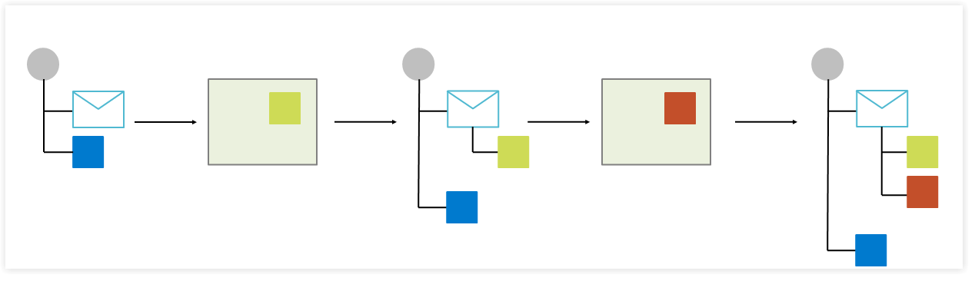
MESSAGE HISTORY
How can we effectively analyze and debug the flow of messages in a loosely coupled system?
Therefore, attach a Message History to the message. The Message History is a list of all applications that the message passed through since its origination.

Slide 46
FAULT TOLERANCE PATTERNS

Slide 47
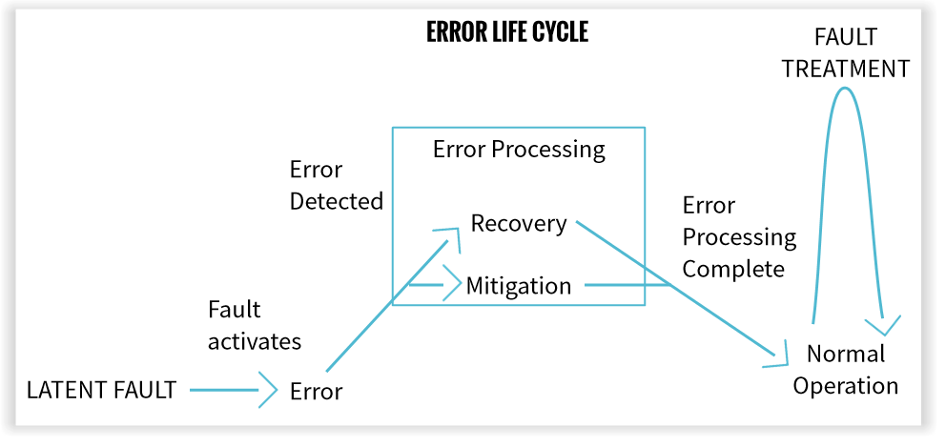
ERROR LIFE CYCLE
Four phases of fault tolerance describe the execution time lifecycle of a fault: error detection, error recovery, error mitigation and fault treatment.
Fault tolerance patterns cover all stages of the error lifecycle.

Slide 48

UNTIS OF MITIGATION
Context/Risk:
You are designing a fault tolerant system and know that there will be faults in the system. You want to avoid the risk of having the whole system failed/unavailable.
Intention:
Avoid cascading failures
Have units of mitigation that contain errors and the recovery mechanism
Solution:
Design fine-grained, decoupled components/services, so they act as units of mitigation, stopping propagation of faults
Can be approached differently: loose coupling, layering, modularity, partitioning, virtual machines/containers, processes, thread pools
Notes:
Considerations:
The dividing line between different parts of the system must be clearly discernable. And the boundary must be respected, dividing the system into discrete parts. The clear separation between parts of the system is important to keep errors contained, which is the primary reason for dividing the system at all.
The units of mitigation are run time entities because error handling is done during execution.
The division of the system into units of mitigation should also consider the recovery and mitigation techniques available to it.
The units of mitigation must be barriers to errors. The boundaries and implementation of the units of mitigation must prevent errors from being communicated outside the boundary.
Similar pattern:
https://learn.microsoft.com/en-us/azure/architecture/patterns/bulkhead

Slide 49

REDUNDANCY
Context/Risk:
In case of errors, the system, which is composed by many software and hardware components, can be unavailable.
Intention:
Reduce the amount of time between error detection and the resumption of normal operation after error recovery.
Solution:
Introduce redundancy in your system
Redundancy can be spatial, temporal, and informational
Spatial redundancy can be Active-Active, Active-Passive, and N+1 (N+M)
In Active-Passive mode, the standby can be hot, warm, or cold
Notes:
Consider three types of redundancy: spatial, temporal, and informational.
Spatial redundancy is present when the system has multiple copies (in different places) that are redundant, which provides alternatives that may be selected with minimal unavailability. It is easy to understand and visualize spatial redundancy in terms of hardware: multiple copies of the hardware platform.
Temporal redundancy refers to redundancy that occurs over time, which helps achieve correct results but lengthens the time of unavailability. Recovery Blocks provide a way to include temporal software redundancy. A program with recovery blocks consists of a primary block and secondary blocks. If the result of the primary block fails its acceptance test then the secondary blocks are executed in sequence until a result is obtained that passes the acceptance test. Recovery Blocks offer primarily temporal redundancy, since they execute sequentially.
When information is repeated it can be used to aid detection and correction, this is informational redundancy. Informational redundancy is provided by having multiple versions of the same data available to the system. The multiple versions can be stored in different places on different types of storage, for example disk and flash memory.
Spatial redundancy methods include Active-Active, Active-Passive, N+1 (generally N+M) redundancy.
Active-Active provides a totally redundant UNITS OF MITIGATION for the critical functionality. At any given time, both of the elements are active and load sharing. However, either of the elements is capable of processing the entire load. Active-active provides the fastest recovery, but it also has a high cost because there is much more capability in the system than is needed for the ordinary workload. Active-Active implies a pairing between the two active units.
In an Active-Standby situation, the standby is again paired with an Active element. But in Active-Standby the standby element is not performing useful work. This means that the same amount of resources is needed as in the Active-Active case but during periods of normal operation the standby is idle.
The choice of redundancy regime has great effect on the speed with which the switching can occur. If the redundant elements are considered to be ‘hot’ standbys the switchover can occur very quickly with minimal outage of the main application. If the standby is only ‘warm’ then it will require time to return to the same application state. CHECKPOINTS (37) help to get there more quickly. When the standby is ‘cold’, it must be started from an inactive state, which adds time. After it has been started it can be treated as a warm standby.
In situations where a one-to-one relationship, such as described by the previous two methods, is too expensive, N+M Redundancy is a useful technique. In this configuration there are N active elements processing the workload of the system. There are also M redundant, standby elements in the system, ready to assume control when a failure occurs in any of the N.

Slide 50

VOTING
Context/Risk:
In case of redundancy that provides multiple answers, how to decide what answer should be used.
Intention:
Arbitrate the results from the redundant components.
Solution:
Devise a voting strategy:
A majority-voting system (uneven number of nodes)
Generalized median voting – select the result that is the median, removing the extremes
Formalized plurality voting – divide the results into partitions, choose at random from the partition with the largest number of members
In case of any disagreement, threat the element that loses the vote as erroneous and begin error processing on it.
Make sure you can trust the entity taking the vote (triple-mode redundancy)
Notes:
Triple modular redundancy:
https://en.wikipedia.org/wiki/Triple_modular_redundancy

Slide 51
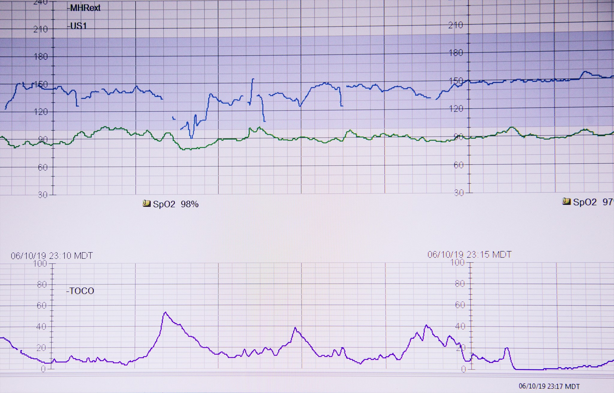
HEARTBEAT
Context/Risk:
A distributed architecture where each component can fail.
Intention:
Errors must be detected as quickly as possible to minimize the Mean Time To Repair attribute of availability.
Solution:
The health reports, or heartbeats, should occur at regular intervals
Two options: the monitored task can send a periodic report to the monitor to show that it is alive or the monitor requests the monitored task give it a report
Weigh the time overhead associated with adding heartbeats (fault tolerance vs. performance tradeoff)

Slide 52

LEAKY BUCKET COUNTER
Context/Risk:
Your system is intended to recognize and correct errors automatically. Not all errors are so critical that the first occurrence of them stimulates error processing.
Intention:
You need to know if an error is transient or permanent.
Solution:
Define your leaky bucket counter:
Set an initial value at the system start-up
Increment the counter when an error occurs
Decrement the counter over specified period but never less than the initial value
If exceeding a predetermined upper threshold, handle the error as permanent

Slide 53
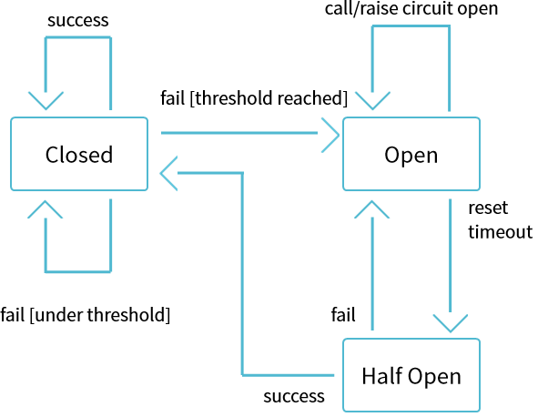
CIRCUIT BREAKER
Context/Risk:
A distributed architecture where components make remote calls to other components. Such remote calls can fail or hang without a response until some timeout limit is reached.
Intention:
Avoid cascading failures
Prevent running out of critical resources
Follow the “fail fast” principle
Solution:
Wrap a protected function call in a circuit breaker object, which monitors for failures.
Once the failures reach a certain threshold, the circuit breaker trips and all further calls return with an error, without the protected call being made at all
Try the protected call again after a suitable interval, and reset the breaker should it succeed
Notes:
Source:
https://martinfowler.com/bliki/CircuitBreaker.html

Slide 54
SECURITY PATTERNS
Federated Identity
Gatekeeper
Valet key

Slide 55
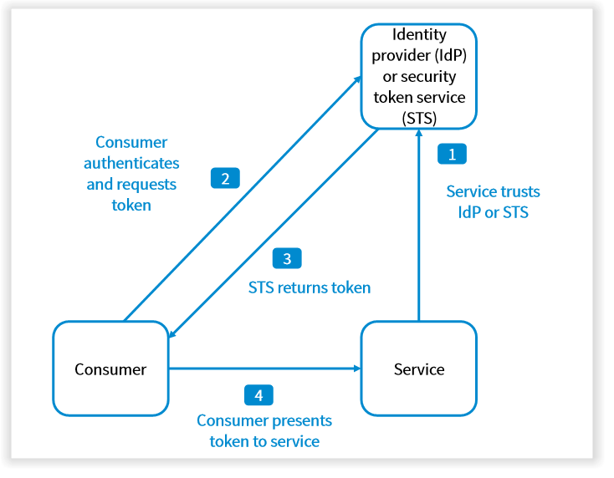
Federated IDENTITY
Context/Risk:
Users typically need to work with multiple applications provided and hosted by different organizations they have a business relationship with.
Intention:
Eliminate disjointed user experience
Minimize security vulnerabilities
Simplify user management
Solution:
Separate user authentication from the application code, and delegate authentication to a trusted identity provider.
Notes:
Using different credentials for multiple applications can:
Cause a disjointed user experience. Users often forget sign-in credentials when they have many different ones.
Expose security vulnerabilities. When a user leaves the company the account must immediately be deprovisioned. It's easy to overlook this in large organizations.
Complicate user management. Administrators must manage credentials for all of the users, and perform additional tasks such as providing password reminders.
When to use this pattern:
Single sign-on in the enterprise. In this scenario you need to authenticate employees for corporate applications that are hosted in the cloud outside the corporate security boundary, without requiring them to sign in every time they visit an application. The user experience is the same as when using on-premises applications where they're authenticated when signing in to a corporate network, and from then on have access to all relevant applications without needing to sign in again.
Federated identity with multiple partners. In this scenario you need to authenticate both corporate employees and business partners who don't have accounts in the corporate directory. This is common in business-to-business applications, applications that integrate with third-party services, and where companies with different IT systems have merged or shared resources.
Federated identity in SaaS applications. In this scenario independent software vendors provide a ready-to-use service for multiple clients or tenants. Each tenant authenticates using a suitable identity provider. For example, business users will use their corporate credentials, while consumers and clients of the tenant will use their social identity credentials.
This pattern might not be useful in the following situations:
All users of the application can be authenticated by one identity provider, and there's no requirement to authenticate using any other identity provider. This is typical in business applications that use a corporate directory (accessible within the application) for authentication, by using a VPN, or (in a cloud-hosted scenario) through a virtual network connection between the on-premises directory and the application.
The application was originally built using a different authentication mechanism, perhaps with custom user stores, or doesn't have the capability to handle the negotiation standards used by claims-based technologies. Retrofitting claims-based authentication and access control into existing applications can be complex, and probably not cost effective.
Source:
https://learn.microsoft.com/en-us/azure/architecture/patterns/federated-identity

Slide 56
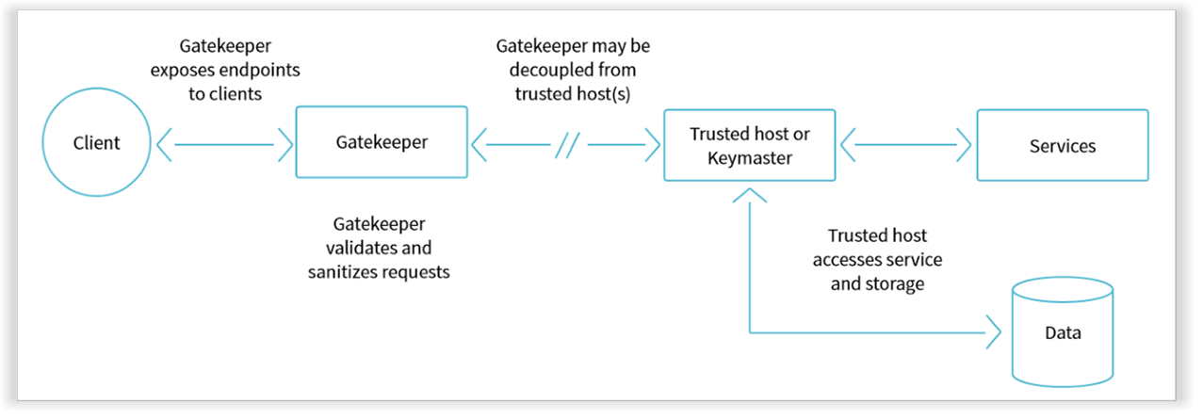
gatekeeper
Context/Risk:
Applications expose their functionality to clients by accepting and processing requests. This code usually also performs authentication and validation. This may introduce vulnerability.
Intention:
Minimize the risk of clients gaining access to sensitive information and services by compromising application’s hosting environment
Solution:
Decouple hosts or tasks that expose public endpoints from the code that processes requests and accesses storage.
Introduce controlled validation
Notes:
The gatekeeper pattern can be used to simply protect storage, or it can be used as a more comprehensive façade to protect all of the functions of the application. The important factors are:
Controlled validation. The gatekeeper validates all requests, and rejects those that don't meet validation requirements.
Limited risk and exposure. The gatekeeper doesn't have access to the credentials or keys used by the trusted host to access storage and services. If the gatekeeper is compromised, the attacker doesn't get access to these credentials or keys.
Appropriate security. The gatekeeper runs in a limited privilege mode, while the rest of the application runs in the full trust mode required to access storage and services. If the gatekeeper is compromised, it can't directly access the application services or data.
This pattern is useful for:
Applications that handle sensitive information, expose services that must have a high degree of protection from malicious attacks, or perform mission-critical operations that shouldn't be disrupted.
Distributed applications where it's necessary to perform request validation separately from the main tasks, or to centralize this validation to simplify maintenance and administration.
Source:
https://learn.microsoft.com/en-us/azure/architecture/patterns/gatekeeper

Slide 57
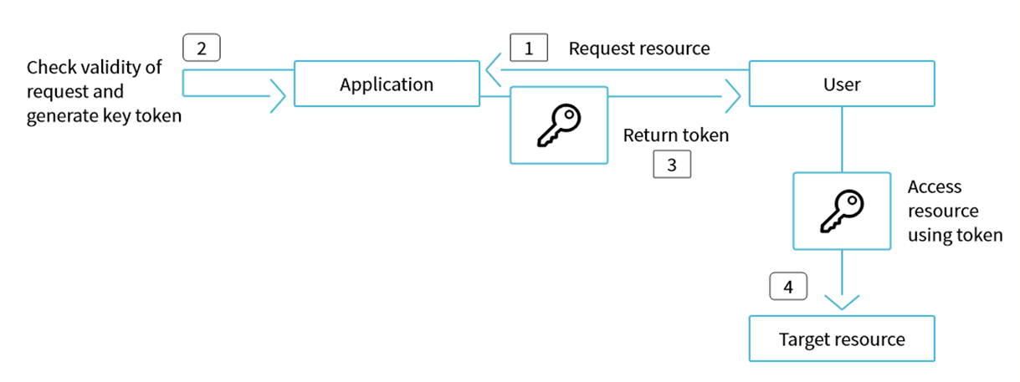
Valet key
Context/Risk:
Typically, the application handles the movement of the data: from storage to the client and from the client to the data store. However, this approach absorbs valuable resources such as compute, memory, and bandwidth.
Data stores have the ability to handle upload and download of data directly. But, this typically requires the client to have access to the security credentials for the store.
Intention:
Minimize data transfer costs and the requirement to scale out the application, and to maximize performance.
Solution:
Restrict access to the data store’s public connection and provide the client with a key or token that the data store can validate. Which will provide time-limited access to specific resources and allows only predefined operations.
Notes:
This pattern is useful for the following situations:
To minimize resource loading and maximize performance and scalability. Using a valet key doesn't require the resource to be locked, no remote server call is required, there's no limit on the number of valet keys that can be issued, and it avoids a single point of failure resulting from performing the data transfer through the application code. Creating a valet key is typically a simple cryptographic operation of signing a string with a key.
To minimize operational cost. Enabling direct access to stores and queues is resource and cost efficient, can result in fewer network round trips, and might allow for a reduction in the number of compute resources required.
When clients regularly upload or download data, particularly where there's a large volume or when each operation involves large files.
When the application has limited compute resources available, either due to hosting limitations or cost considerations. In this scenario, the pattern is even more helpful if there are many concurrent data uploads or downloads because it relieves the application from handling the data transfer.
When the data is stored in a remote data store or a different datacenter. If the application was required to act as a gatekeeper, there might be a charge for the additional bandwidth of transferring the data between datacenters, or across public or private networks between the client and the application, and then between the application and the data store.
This pattern might not be useful in the following situations:
If the application must perform some task on the data before it's stored or before it's sent to the client. For example, if the application needs to perform validation, log access success, or execute a transformation on the data. However, some data stores and clients are able to negotiate and carry out simple transformations such as compression and decompression (for example, a web browser can usually handle GZip formats).
If the design of an existing application makes it difficult to incorporate the pattern. Using this pattern typically requires a different architectural approach for delivering and receiving data.
If it's necessary to maintain audit trails or control the number of times a data transfer operation is executed, and the valet key mechanism in use doesn't support notifications that the server can use to manage these operations.
If it's necessary to limit the size of the data, especially during upload operations. The only solution to this is for the application to check the data size after the operation is complete, or check the size of uploads after a specified period or on a scheduled basis.
Source:
https://learn.microsoft.com/en-us/azure/architecture/patterns/valet-key

Slide 58
ZERO-DOWNTIME RELEASE

Slide 59
OVERVIEW
“
ZERO-DOWNTIME RELEASE, also known as hot deployment, is one in which the actual process of switching users from one release to another happens nearly instantaneously.
Crucially, it must also be possible to back users out to the previous version nearly instantaneously too, if something goes wrong.
”
Such techniques as blue-green deployments and canary releasing can be used to perform zero-downtime releases.
Notes:
The key to zero-downtime releases is decoupling the various parts of the release process so they can happen independently as far as possible. In particular, it should be possible to put in place new versions of shared resources your applications depend on, such as databases, services, and static resources, before you upgrade your applications.
With static resources and web-based services, this is relatively easy.
Things are a little harder with databases.
Source:
“Continuous Delivery” by Jez Humble and David Farley

Slide 60
BLUE-GREEN DEPLOYMENT
The idea is to have two identical versions of your production environment, blue and green. Users of the system are routed to the green environment, which is the currently designated production.
Service A
Service B
Service C
Users
Router
Service A
Service B
Service C
Notes:
Source:
https://martinfowler.com/bliki/BlueGreenDeployment.html

Slide 61
CANARY RELEASE
CANARY RELEASE is a technique to reduce the risk of introducing a new software version in production by slowly rolling out the change to a small subset of users before rolling it out to the entire infrastructure and making it available to everybody.
Service A
Service B
Most users
Service C
Users
Router
Version N
Service A
Service B
Some users
Service C
Version N+1
Notes:
Source:
https://martinfowler.com/bliki/CanaryRelease.html

Slide 62
FEATURE FLAGS
FEATURE FLAGS (also known as feature toggles or feature switches) are a software development technique that turns certain functionality on and off during runtime without deploying new code. The idea behind feature flags is to build conditional feature branches into code in order to make logic available only to specific groups of users at a time.
Quicker Release
Cycles
Feature flags use-cases
Continuous Deployment
Rollback / Kill Switch
Feature Gating
Server-Side A/B Testing
Testing in Production
Notes:
A feature flag release varies from a canary release, as feature flags are used to expose a specific feature to a small subgroup of users. A canary release exposes a particular version of the entire application or service. There are many benefits to incorporating feature toggles into your release process. The following are some common use cases.
Testing in Production: feature flags allow development teams to test new features in production while mitigating the risk of a poor release by providing a way to quickly roll back the feature via a kill switch if necessary. They allow validating the functionality of new feature releases in the real world while minimizing the risk and encourage trunk-based development, which helps prevent merge conflicts from divergent code paths.
Quicker Release Cycles: using feature flags, a team can modify a system’s behavior without making disruptive code changes to the live code. Thus, one of the feature flags’ important benefits is the simplicity of their deployment in the development process. Feature flags decouple feature lifecycle management from code deployment, freeing up the engineering team to work on other tasks.
Rollback / Kill Switch: using feature flags significantly simplifies enabling or disabling new features. If a bug is discovered in a new feature, it can be rolled back instantly without changing your source code. This is useful for mobile app developers, who can use feature flags to release or roll back new features without going through the lengthy app store review process.
Server-Side A/B Testing: developers can implement A/B tests using feature flags by enabling a feature for half of the segment of users, and disabling the feature for the other half, and seeing how the two perform against each other for a certain metric. Feature flags allow to A/B test various features within products with no need for code deployment. Google, Facebook, Amazon, and Netflix A/B test new features before deploying to their full user base.
Feature Gating: feature flags can be used to implement targeted rollouts of features to a specific subset of your users. This can be great for A/B testing features for specific segments of your audience. Still, it can also be used to release features to only a subset of your users, for example, granting users in your enterprise tier access to features that aren’t available in lower tiers.
Continuous Deployment: feature flags have the ability to allow quick learning. Feature flagging enables companies to continuously deliver and deploy software to their users in a faster way. The use of feature flags allows companies to perform gradual feature rollouts, fix bugs in the code without redeploying, experience a more streamlined development cycle, and do rollbacks of code more easily.

Slide 63


References
Books
“Software Architecture in Practice, 4th Edition” by SEI
“Software Architecture Patterns” by Mark Richards
“Enterprise Integration Patterns” by Gregor Hohpe, Bobby Woolf
“Patterns for Fault Tolerant Software” by Hanmer, Robert S.
“Continuous Delivery” by Jez Humble and David Farley
Notes:
https://www.amazon.com/Software-Architecture-Practice-3rd-Engineering/dp/0321815734
https://www.oreilly.com/library/view/software-architecture-patterns/9781491971437/
https://www.amazon.com/Enterprise-Integration-Patterns-Designing-Deploying/dp/0321200683
https://www.amazon.com/Patterns-Fault-Tolerant-Software-Wiley-ebook/dp/B00DXK33SK/
https://www.amazon.com/Continuous-Delivery-Deployment-Automation-Addison-Wesley/dp/0321601912/

Slide 64
Questions ?

